Slide 1
Sequential CPU Implementation

Slide 2
Outline
Logic design
Organizing Processing into Stages
SEQ timing
Suggested Reading 4.2,4.3.1 ~ 4.3.3

Slide 3
Arithmetic Logic Unit
0
1
2
3
Y
A
Y
A
Y
A
Y
A
A
L
U
A
L
U
A
L
U
A
L
U
X + Y
X - Y
X & Y
X ^ Y
X
B
OF
X
B
OF
X
B
OF
X
B
OF
ZF
ZF
ZF
ZF
SF
SF
SF
SF
Combinational logic
  Continuously responding to inputs
Control signal selects function computed
  Corresponding to 4 arithmetic/logical operations in Y86
Also computes values for condition codes
We will use it as a basic component for our CPU

Slide 4
Storage
Registers
  Hold single words or bits
  Loaded as clock rises
  Not only program registers
I
O
Clock

Slide 5
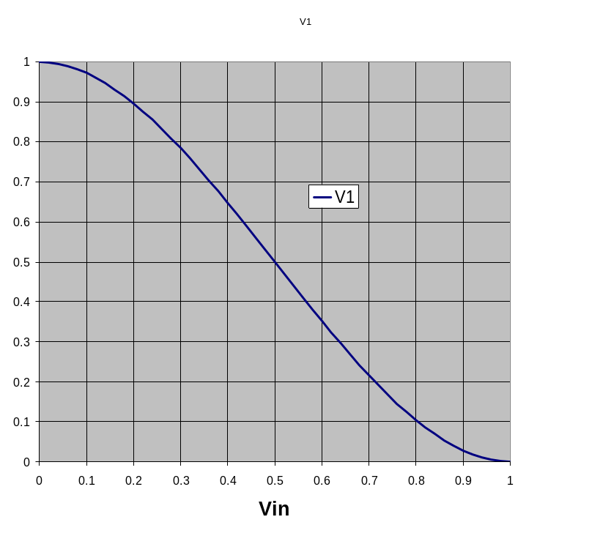
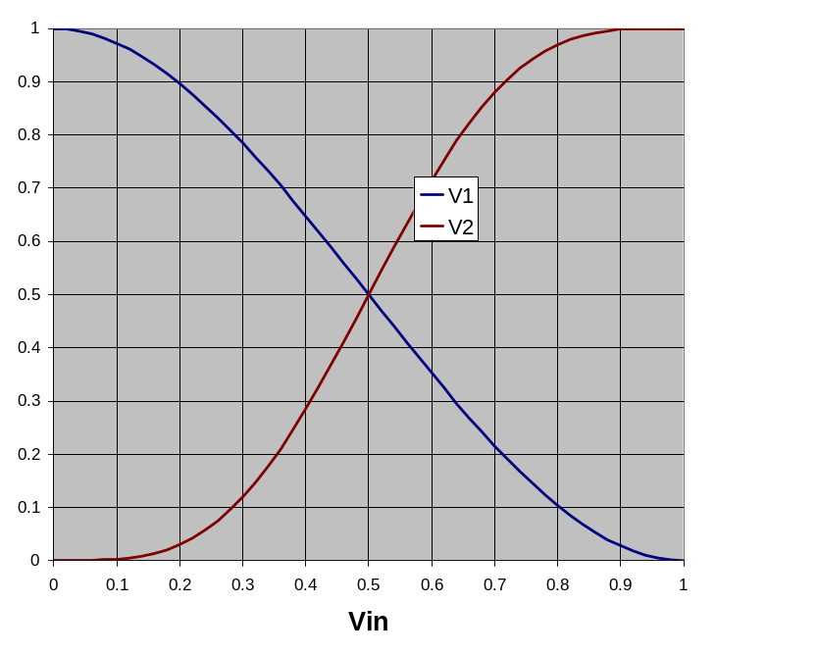
Storing 1 Bit
q
Q+
Bistable Element
!q
Q–
q = 0 or 1
V₂
V_{in}
V₁

Slide 6
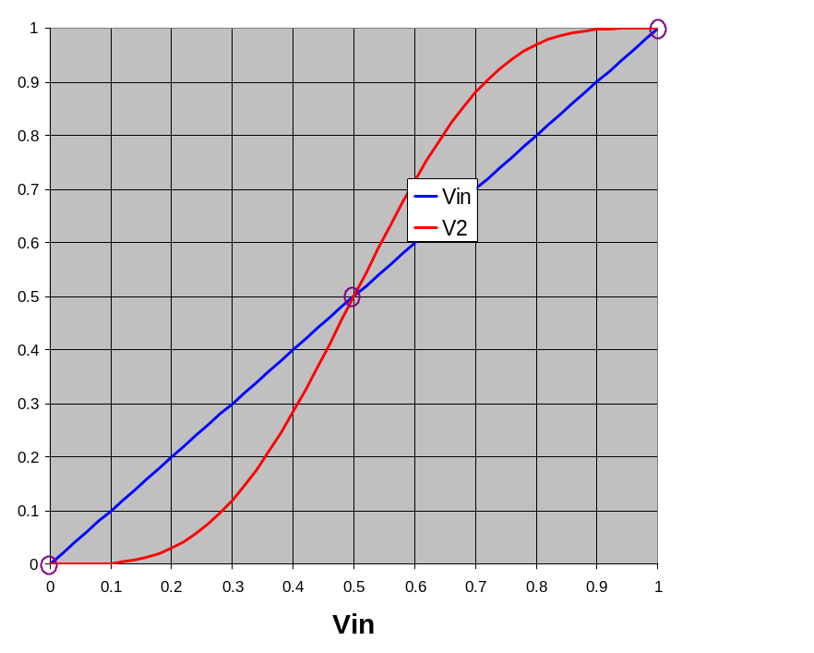
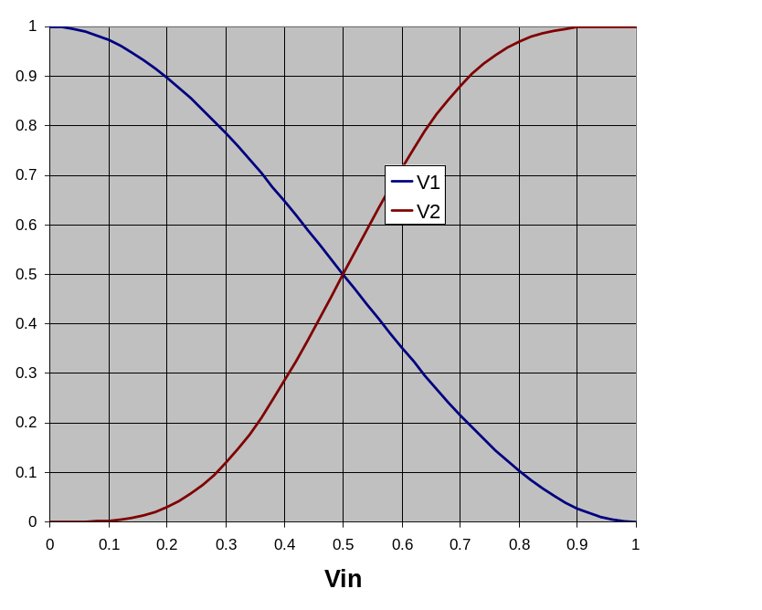
Storing 1 Bit (cont.)
q
Q+
Bistable Element
!q
Q–
q = 0 or 1
Stable 1
V_{in} = V₂
V₂
V₂
Metastable
V_{in}
V_{in}
V₁
V₁
Stable 0

Slide 7
Physical Analogy
Stable 1
Metastable
Stable 0
Metastable
Stable left
.
.
Stable right
.

Slide 8
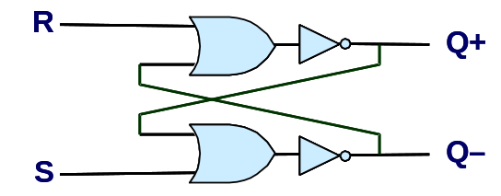
Storing and Accessing 1 Bit
Bistable Element
R-S Latch
q
R
Q+
Q+
!q
Q–
Q–
S
q = 0 or 1
Resetting
Setting
Storing
1
1
0
0
0
1
0
!q
q
0
0
1
1
1
0
0
q
!q

Slide 9
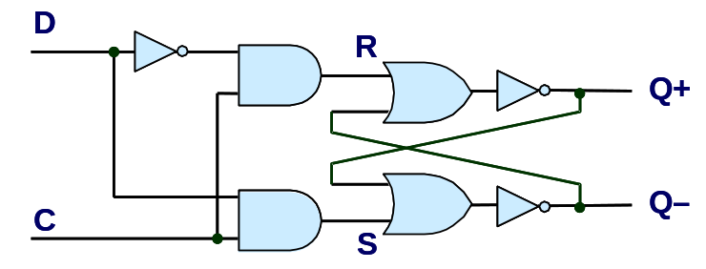
1-Bit Latch
D Latch
D
R
Data
Q+
C
Q–
Clock
S
Latching
Storing
d
!d
!d
!d
d
d
!d
0
!q
q
1
0
!q
d
d
!d
0
q

Slide 10
Transparent 1-Bit Latch
Latching
Changing D
d
!d
!d
!d
d
C
D
1
Q+
d
d
!d
Time
  When in latching mode, combinational propogation from D to Q+ and Q–
  Value latched depends on value of D as C falls
Notes:
No explicit R-S control signal
When c=0, R-S latch is in store mode

Slide 11
Edge-Triggered Latch
D
R
Data
Q+
Q–
C
S
T
Clock
Trigger
  Only in latching mode for brief period
    Rising clock edge
  Value latched depends on data as clock rises
  Output remains stable at all other times
C
T
D
Q+
Time
Notes:
More stable

Slide 12
Registers
Structure
i₇
D
o₇
C
Q+
i₆
D
o₆
C
Q+
i₅
D
o₅
C
Q+
i₄
D
o₄
C
Q+
I
O
i₃
D
o₃
C
Q+
i₂
D
o₂
C
Q+
i₁
D
o₁
Clock
C
Q+
i₀
D
o₀
C
Q+
Clock
  Stores word of data
    Different from program registers seen in assembly code
  Collection of edge-triggered latches
  Loads input on rising edge of clock

Slide 13
Register Operation
State = x
Rising
clock
State = y
Input = y
x
Output = x
y
Output = y
Stores data bits
For most of time acts as barrier between input and output
As clock rises, loads input

Slide 14
State Machine Example
0
Comb. Logic
0
A
L
U
MUX
0
Out
In
1
Load
Clock

Slide 15
State Machine Example
Comb. Logic
0
?
A
L
U
MUX
0
x₀
Out
?
x₀
In
1
Load
1
Clock
Clock
Load
In
x₀
Out

Slide 16
State Machine Example
Comb. Logic
0
X₀
A
L
U
MUX
0
x₀+x₀
x₀
Out
In
x₀
1
Load
0
Clock
Clock
Load
In
x₀
Out
x₀

Slide 17
State Machine Example
Comb. Logic
0
X₀
A
L
U
MUX
0
x₀
Out
x₀+x₁
x₁
In
1
Load
0
Clock
Clock
Load
In
x₀
x₁
Out
x₀

Slide 18
State Machine Example
Comb. Logic
Accumulator circuit
Load or accumulate on each cycle
0
A
L
U
MUX
0
Out
In
1
Load
0
Clock
Clock
Load
In
x₀
x₁
x₂
x₃
x₄
x₅
Out
x₀
x₀+x₁
x₀+x₁+x₂
x₃
x+x₄
x₃+x₄+x₅

Slide 19
Building Blocks
Combinational Logic
  Compute Boolean functions of inputs
  Continuously respond to input changes
  Operate on data and implement control
Storage Elements
  Store bits
  Addressable memories
  Non-addressable registers
  Loaded only as clock rises
fun
=
A
A
L
U
B
MUX
0
1
valA
Register
file
srcA
A
valW
W
dstW
valB
srcB
B
Clock
Clock

Slide 20
Summary
Storage
  Registers
    Hold single words
    Loaded as clock rises
  Random-access memories
    Hold multiple words
    Possible multiple read or write ports
    Read word when address input changes
    Write word as clock rises

Slide 21
Instruction Decoding
Optional
Optional
5
0
rA
rB
D
icode
ifun
rA
rB
valC
Instruction Format
  Instruction byte icode:ifun
  Optional register byte rA:rB
  Optional constant word valC

Slide 22
Y86 Instruction Set #1
rrmovl
2
0
Byte
0
1
2
3
4
5
cmovle
2
1
halt
0
0
cmovl
2
2
nop
1
0
cmove
2
3
cmovXX rA, rB
2
fn
rA
rB
cmovne
2
4
irmovl V, rB
3
0
F
rB
V
cmovge
2
5
rmmovl rA, D(rB)
4
0
rA
rB
D
cmovg
2
6
mrmovl D(rB), rA
5
0
rA
rB
D
OPl rA, rB
6
fn
rA
rB
jXX Dest
7
fn
Dest
call Dest
8
0
Dest
ret
9
0
pushl rA
A
0
rA
F
popl rA
B
0
rA
F

Slide 23
Y86 Instruction Set #2
Byte
0
1
2
3
4
5
halt
0
0
addl
6
0
nop
1
0
subl
6
1
cmovXX rA, rB
2
fn
rA
rB
andl
6
2
irmovl V, rB
3
0
F
rB
V
xorl
6
3
rmmovl rA, D(rB)
4
0
rA
rB
D
mrmovl D(rB), rA
5
0
rA
rB
D
OPl rA, rB
6
fn
rA
rB
jXX Dest
7
fn
Dest
call Dest
8
0
Dest
ret
9
0
pushl rA
A
0
rA
F
popl rA
B
0
rA
F

Slide 24
Y86 Instruction Set #3
Byte
0
1
2
3
4
5
halt
0
0
nop
1
0
rrmovl rA, rB
2
fn
rA
rB
irmovl V, rB
3
0
F
rB
V
rmmovl rA, D(rB)
4
0
rA
rB
D
jmp
7
0
mrmovl D(rB), rA
5
0
rA
rB
D
jle
7
1
OPl rA, rB
6
fn
rA
rB
jl
7
2
jXX Dest
7
fn
Dest
je
7
3
call Dest
8
0
Dest
jne
7
4
ret
9
0
jge
7
5
pushl rA
A
0
rA
F
jg
7
6
popl rA
B
0
rA
F

Slide 25
Instruction Execution Stages
Fetch
  Read instruction from instruction memory
Decode
  Read program registers
Execute
  Compute value or address
Memory
  Read or write data
Write Back
  Write program registers
PC
  Update program counter
Notes:
可能不是每条指令都需要执行每个阶段，而且让指令做一些它不需要的工作会降低速度。
但一个统一的框架可以将实现的复杂度降到最小。因为它们可以尽可能的共用一些部件。
比方说，ALU，如果我们允许不同的指令有不同的执行路径，那么可能就需要几个ALU来实现不同的目的。重复一些硬件电路的开销要比软件大的多。
另外，一个统一的框架也会使得处理各种特殊情况和硬件的各种古怪行为变得比较容易。
各个阶段是顺序进行的，但一个阶段内的内容是基本上并行执行的。

Slide 26
Executing Arith./Logical Operation
OPl rA, rB
6
fn
rA
rB
Fetch
  Read 2 bytes
Decode
  Read operand registers
Execute
  Perform operation
  Set condition codes
Memory
  Do nothing
Write back
  Update register
PC Update
  Increment PC by 2

Slide 27
Stage Computation: Arith/Log. Ops
OPl rA, rB
Fetch
icode:ifun ← M₁[PC]
Read instruction byte
rA:rB ← M₁[PC+1]
Read register byte
valP ← PC+2
Compute next PC
Decode
valA ← R[rA]
Read operand A
valB ← R[rB]
Read operand B
Execute
valE ← valB OP valA
Perform ALU operation
Set CC
Set condition code register
Memory
Write
back
R[rB] ← valE
Write back result
PC update
PC ← valP
Update PC

Slide 28
SEQ Hardware Structure
Instruction Flow
  Read instruction at address specified by PC
  Process through stages
  Update program counter
Notes:
一个比较怪的地方是：我们的指令执行图是从下到上的。这种设计的原因等到PIPE的实现时我们会解释的。
之所以Write back阶段和PC Update阶段要回下来，是因为他们要访问Register file和PC这两个前面阶段用过的部件。
要注意的是虽然在语义动作中说各个可能写状态的阶段写状态的动作是顺序发生的。但实际上对于硬件来说，它们是同时在clock rising的时候发生的。

Slide 29
PC
,
Write back
Memory
Data memory
valE
CC
ALU
Execute
CC
aluA,aluB
valA, valB
valE
Decode
srcA, srcB
A B
Register File
M
E
icode ifun
rA rB
Register
dstB
valP
Instruction memory
Fetch
Instruction
PC increment
PC
newPC
Notes:
一个比较怪的地方是：我们的指令执行图是从下到上的。这种设计的原因等到PIPE的实现时我们会解释的。
之所以Write back阶段和PC Update阶段要回下来，是因为他们要访问Register file和PC这两个前面阶段用过的部件。
要注意的是虽然在语义动作中说各个可能写状态的阶段写状态的动作是顺序发生的。但实际上对于硬件来说，它们是同时在clock rising的时候发生的。

Slide 30
Stage Computation
Formulate instruction execution as sequence of simple steps
Use same general form for all instructions
Notes:
注意：execute中的运算是valB OP valA，而不是valA OP valB
M1[PC] 表示从PC开始的内存中读取一个字节的数据。

Slide 31
Executing rrmovl
rrmovl rA, rB
2
0
rA
rB
Fetch
  Read 2 bytes
Decode
  Read operand register rA
Execute
  Do nothing
Memory
  Do nothing
Write back
  Update register
PC Update
  Increment PC by 2

Slide 32
Stage Computation: rrmovl
rrmovl rA, rB
Fetch
icode:ifun ← M₁[PC]
Read instruction byte
rA:rB ← M₁[PC+1]
Read register byte
valP ← PC+2
Compute next PC
Decode
valA ← R[rA]
Read operand A
Execute
valE ← 0 + valA
Perform ALU operation
Memory
Write
back
R[rB] ← valE
Write back result
PC update
PC ← valP
Update PC
Notes:
虽然，rrmovl在execute阶段不需要运算。但因为我们使用的是一个统一的框架，每条指令都必须通过每个阶段，所以execute总要干点什么事情。
而且，因为我们为了简化起见，在memory和write back阶段都尽量使用execute产生的结果，这样可以减少信号传递的数量。
比如，这样做以后，我们用valE作为传递给write back阶段的内容，而不是valA。这样就使得本指令的write back阶段和前面的OPl一模一样（无论是动作还是数据源）。
一个原则就是：尽可能使得每一步的操作都非常一致，这样就可以简化电路设计。
Simplicity favors regularity.

Slide 33
Executing irmovl
irmovl V, rB
3
0
F
rB
V
Fetch
  Read 6 bytes
Decode
  Do nothing
Execute
  Do nothing
Memory
  Do nothing
Write back
  Update register
PC Update
  Increment PC by 6

Slide 34
Stage Computation: irmovl
irmovl rA, rB
Fetch
icode:ifun ← M₁[PC]
Read instruction byte
rA:rB ← M₁[PC+1]
Read register byte
valC ← M₄[PC+2]
Read constant value
valP ← PC+6
Compute next PC
Decode
Execute
valE ← 0 + valC
Perform ALU operation
Memory
Write
back
R[rB] ← valE
Write back result
PC update
PC ← valP
Update PC

Slide 35
Executing rmmovl
rmmovl rA, D(rB)
4
0
rA
rB
D
Fetch
  Read 6 bytes
Decode
  Read operand registers
Execute
  Compute effective address
Memory
  Write to memory
Write back
  Do nothing
PC Update
  Increment PC by 6

Slide 36
Stage Computation: rmmovl
rmmovl rA, D(rB)
Fetch
icode:ifun ← M₁[PC]
Read instruction byte
rA:rB ← M₁[PC+1]
Read register byte
valC ← M₄[PC+2]
Read displacement D
valP ← PC+6
Compute next PC
Decode
valA ← R[rA]
Read operand A
valB ← R[rB]
Read operand B
Execute
valE ← valB + valC
Compute effective address
Memory
M₄[valE] ← valA
Write value to memory
Write
back
PC update
PC ← valP
Update PC
  Use ALU for address computation

Slide 37
Executing mrmovl
mrmovl D(rB),rA
5
0
rA
rB
D
Fetch
  Read 6 bytes
Decode
  Read operand registers rB
Execute
  Compute effective address
Memory
  Read from memory
Write back
  Update register rA
PC Update
  Increment PC by 6
Notes:
这里有一个特点，指令中rB是在rA之前。这主要是为了和rmmovl保持统一。

Slide 38
Stage Computation: mrmovl
mrmovl D(rB) , rA
Fetch
icode:ifun ← M₁[PC]
Read instruction byte
rA:rB ← M₁[PC+1]
Read register byte
valC ← M₄[PC+2]
Read displacement D
valP ← PC+6
Compute next PC
Decode
valB ← R[rB]
Read operand B
Execute
valE ← valB + valC
Compute effective address
Memory
valM ← M₄[valE]
Read data from memory
Write
back
R[rA] ← valM
Update register rA
PC update
PC ← valP
Update PC
Use ALU for address computation
Notes:
通过让rB来寻址，就使得本指令和rmmovl在Execute阶段的运算是完全一致的。

Slide 39
Executing pushl
pushl rA
a
0
rA
F
Fetch
  Read 2 bytes
Decode
  Read stack pointer and rA
Execute
  Decrement stack pointer by 4
Memory
  Store valA at the address of new stack pointer
Write back
  Update stack pointer
PC Update
  Increment PC by 2

Slide 40
Stage Computation: pushl
pushl rA
Fetch
icode:ifun ← M₁[PC]
Read instruction byte
rA:rB ← M₁[PC+1]
Read register byte
valP ← PC+2
Compute next PC
Decode
valA ← R[rA]
Read valA
valB ← R [%esp]
Read stack pointer
Execute
valE ← valB + (-4)
Decrement stack pointer
Memory
M₄[valE] ← valA
Store to stack
Write
back
R[%esp] ← valE
Update stack pointer
PC update
PC ← valP
Update PC
Use ALU to Decrement stack pointer
Notes:
可能大家觉得这种做法有问题。因为这样在write back之前实际上写入的元素在堆栈外。
如果发生一个缺页中断，那么指令要在memory阶段被suspend, 然后转向中断子程序处理内存访问，
而在子程序中有可能用到堆栈，但这时堆栈该位置的数据还没有被保存，所以还没有数据在堆栈外。
如果没有缺页或者缺页处理完毕，那么不会有中断出现在write back和memory之间。所以没有问题。

Slide 41
Executing popl
popl rA
b
0
rA
F
Fetch
  Read 2 bytes
Decode
  Read stack pointer
Execute
  Increment stack pointer by 4
Memory
  Read from old stack pointer
Write back
  Update stack pointer
  Write result to register
PC Update
  Increment PC by 2
Notes:
在写回阶段要写两个寄存器，这两个写是有先后次序的。必须按照上面的方法进行，因为rA可能就是%esp。具体见书P270 Practice Problem 4.5.

Slide 42
Stage Computation: popl
popl rA
Fetch
icode:ifun ← M₁[PC]
Read instruction byte
rA:rB ← M₁[PC+1]
Read register byte
valP ← PC+2
Compute next PC
Decode
valA ← R[%esp]
Read stack pointer
valB ← R [%esp]
Read stack pointer
Execute
valE ← valB + 4
Increment stack pointer
Memory
valM ← M₄[valA]
Read from stack
Write
back
R[%esp] ← valE
Update stack pointer
R[rA] ← valM
Write back result
PC update
PC ← valP
Update PC

Slide 43
Stage Computation: popl
Use ALU to increment stack pointer
Must update two registers
  Popped value
  New stack pointer
Notes:
比较奇特的地方是在Decode阶段，同时计算valA和valB，而这两个值是一样的，这样做显然是冗余的。
但这样做的好处是下面的整个流程就与pushl指令非常类似了。例如，在execute阶段，都是valB参与运算；
在memory阶段，都是valA参与运算。因为pop指令与pushl rmmovl mrmovl指令都是访存指令，类似之间的相似性越多，就容易实现。
在写回阶段要写两个寄存器，这两个写是有先后次序的。必须按照上面的方法进行，因为rA可能就是%esp。具体见书P270 Practice Problem 4.5.

Slide 44
Executing Jumps
jXX Dest
7
fn
Dest
fall thru:
XX
XX
Not taken
target:
XX
XX
Taken

Slide 45
Executing Jumps
Fetch
  Read 5 bytes
  Increment PC by 5
Decode
  Do nothing
Execute
  Determine whether to take branch based on jump condition and condition codes
Memory
  Do nothing
Write back
  Do nothing
PC Update
  Set PC to Dest if branch taken or to incremented PC if not branch

Slide 46
Stage Computation: Jumps
jXX Dest
Fetch
icode:ifun ← M₁[PC]
Read instruction byte
valC ← M₄[PC+1]
Read destination address
valP ← PC+5
Fall through address
Decode
Execute
Cnd ← Cond(CC,ifun)
Take branch?
Memory
Write
back
PC update
PC ← Cnd ? valC : valP
Update PC

Slide 47
Stage Computation: Jumps
Compute both addresses
Choose based on setting of condition codes and branch condition

Slide 48
Executing call
call Dest
8
0
Dest
return:
XX
XX
target:
XX
XX

Slide 49
Executing call
Fetch
  Read 5 bytes
  Increment PC by 5
Decode
  Read stack pointer
Execute
  Decrement stack pointer by 4
Memory
  Write incremented PC to new value of stack pointer
Write back
  Update stack pointer
PC Update
  Set PC to Dest

Slide 50
Stage Computation: call
call Dest
Fetch
icode:ifun ← M₁[PC]
Read instruction byte
valC ← M₄[PC+1]
Read destination address
valP ← PC+5
Compute return point
Decode
valB ← R[%esp]
Read stack pointer
Execute
valE ← valB + –4
Decrement stack pointer
Memory
M₄[valE] ← valP
Write return value on stack
Write
back
R[%esp] ← valE
Update stack pointer
PC update
PC ← valC
Set PC to destination

Slide 51
Stage Computation: call
Use ALU to decrement stack pointer
Store incremented PC

Slide 52
Executing ret
ret
9
0
return:
XX
XX

Slide 53
Executing ret
Fetch
  Read 1 byte
Decode
  Read stack pointer
Execute
  Increment stack pointer by 4
Memory
  Read return address from old stack pointer
Write back
  Update stack pointer
PC Update
  Set PC to return address

Slide 54
Stage Computation: ret
ret
Fetch
icode:ifun ← M₁[PC]
Read instruction byte
Decode
valA ← R[%esp]
Read operand stack pointer
valB ← R[%esp]
Read operand stack pointer
Execute
valE ← valB + 4
Increment stack pointer
Memory
valM ← M₄[valA]
Read return address
Write
back
R[%esp] ← valE
Update stack pointer
PC update
PC ← valM
Set PC to return address
Notes:
Execute: operate on ValB
Memory: operate on ValA

Slide 55
Stage Computation: ret
Use ALU to increment stack pointer
Read return address from memory

Slide 56
Next
SEQ Implementation
Suggested Reading 4.3.1, 4.3.4

